Slide 1
Procurement Companion
Novartis
Nikhil S G
241058024
Project Start Date : 08/07/2025

Slide 2
Key Contacts
HR Details: | Guide at Industry :
Karuna Shettennavar | Deepti Bandi
Talent Acquisition BP Early Talent | Proc. Team Manager -Analytics&Insights
CoE Talent Acquisition 1 | Procurement Governance & Processes

Slide 3
Contents
Introduction
Methodology
Work Done
Results
Future Work
References

Slide 4
Introduction
Procurement Companion
1] AI-Powered Procurement Platform
Centralized solution designed to automate workflows, ensure compliance, and simplify complex procurement processes.
2] Integration with SAP Ariba
Seamless connectivity for accurate contract data retrieval, governance compliance, and unified sourcing activities.
3] Intelligent Features & Automation
Natural language queries, automated metadata extraction, and real-time insights to reduce manual effort and speed up operations.
4] Driving Digital Transformation
Enhances decision-making, supports strategic sourcing, and aligns with Novartis’ vision for innovation and operational excellence.

Slide 5
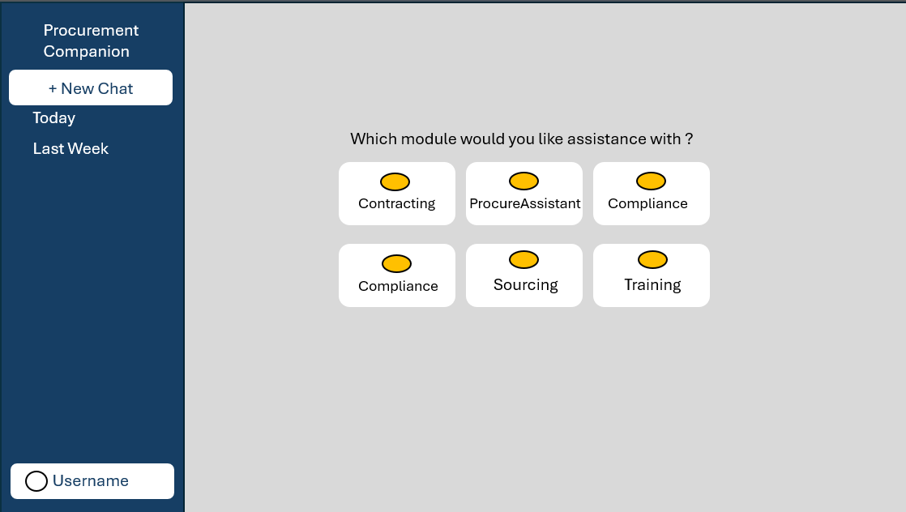
Explore the interactive dashboard of Procurement Companion for real-time insights and streamlined
workflows.

Slide 6
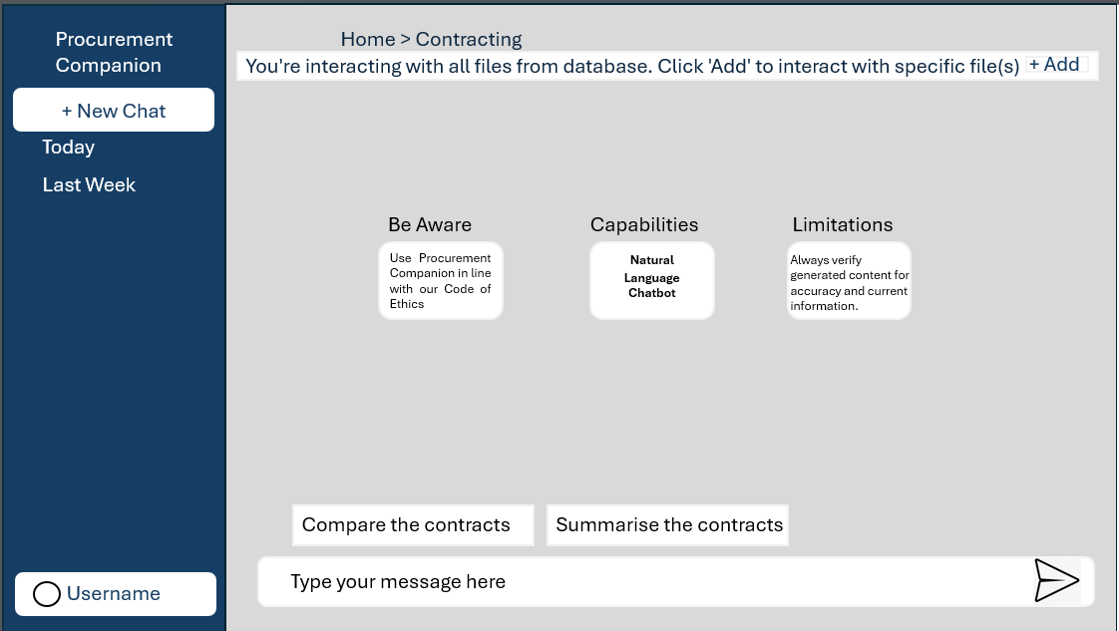
Contracting Module for managing agreements.

Slide 7
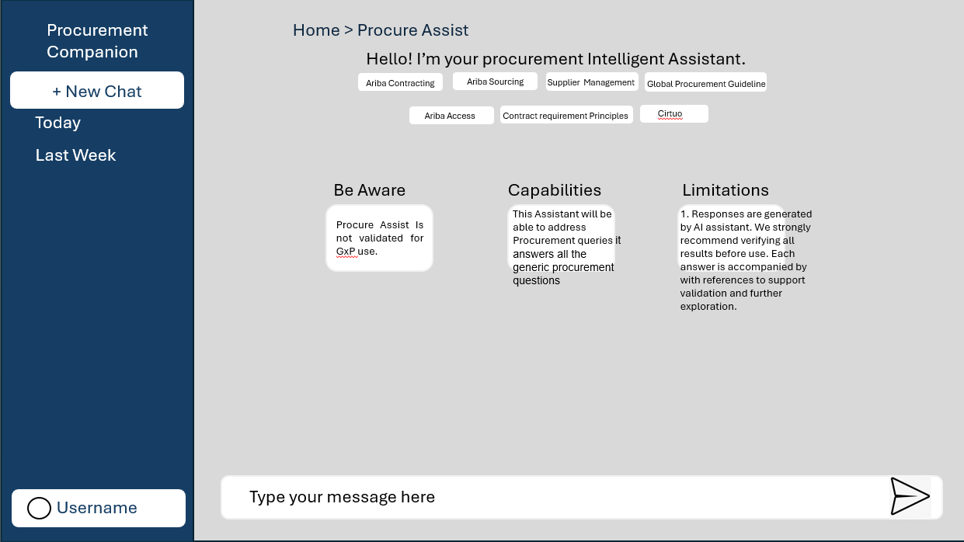
ProcureAssist for AI-driven procurement support.

Slide 8
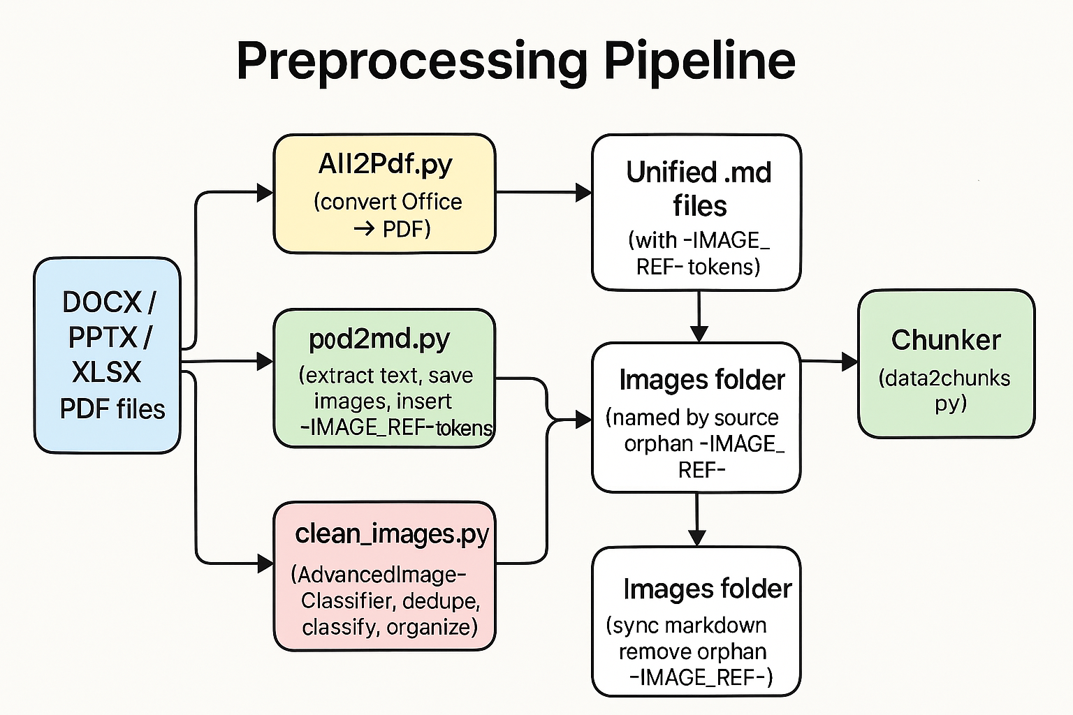
Methodology
1 Preprocessing Pipeline
Standardizes diverse procurement documents (DOCX, PPTX, XLSX, PDF) into a unified Markdown format, preserving both text and visual references with positional image tokens. This ensures accurate chunking and reliable retrieval, maintaining document structure and context

Slide 9
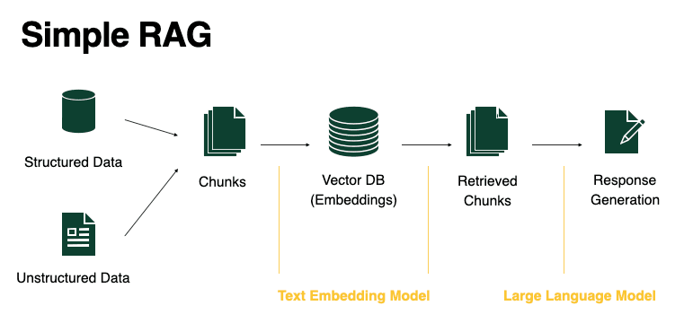
2. Retrieval-Augmented Generation (RAG) Architecture
Combines semantic search (using FAISS and Azure OpenAI embeddings) with a generative language model to deliver grounded, context-rich answers strictly from indexed procurement documents, ensuring compliance and eliminating hallucinations.

Slide 10
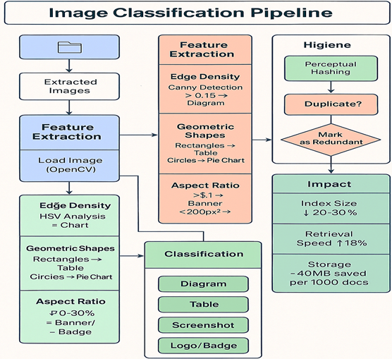
Work Done
1. Image Classification Contributions
A major technical achievement was the development and deployment of a deterministic, rule-based image classification pipeline tailored for procurement documents. Using OpenCV, the system extracts four key features—edge density, color histogram, geometric shapes, and aspect ratio—to categorize images as diagrams, tables, charts, screenshots, logos, or redundant visuals. Hygiene operations, including perceptual hashing for deduplication and markdown reference cleanup, reduced the FAISS index size by 20–30% and improved retrieval speed by 18%. This approach ensures only meaningful visuals are retained for downstream semantic search and UI display, enhancing both retrieval precision and user clarity without relying on machine learning models.

Slide 11
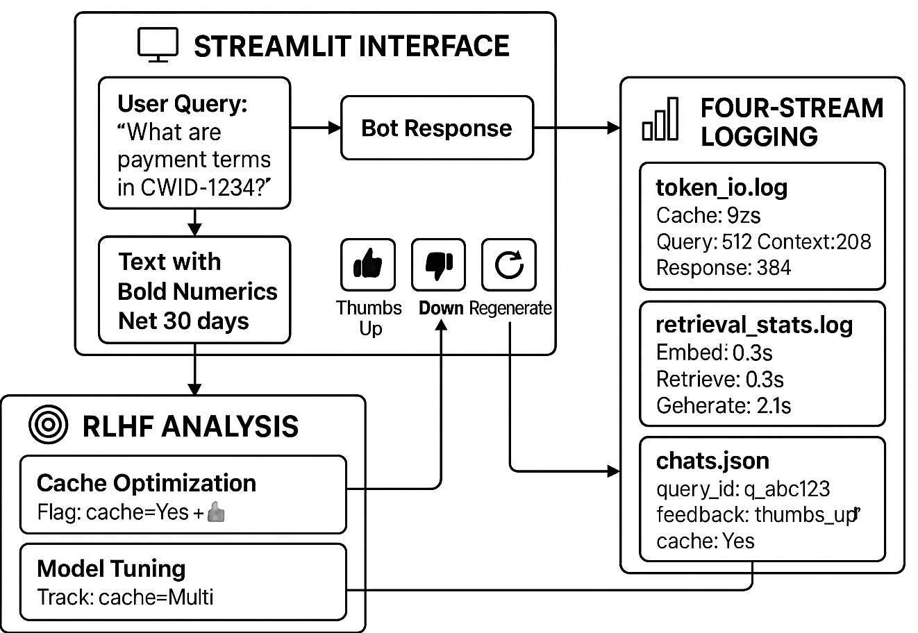
2. User Experience & Feedback Logging
To maximize usability, a custom Streamlit-based UI was implemented, featuring a dark/light theme toggle, fixed bottom input for seamless chat interaction, and embedded image rendering via Markdown tokens. User feedback is captured through inline thumbs-up/down buttons, with all responses and feedback logs stored for RLHF (Reinforcement Learning from Human Feedback) analysis. The architecture supports real-time regeneration of answers, cache optimization, and detailed logging across four streams—token usage, retrieval stats, pipeline events, and chat history. These enhancements have led to an 86% positive feedback rate and an 84% reduction in query resolution time, demonstrating strong user adoption and continuous improvement in both performance and compliance.

Slide 12
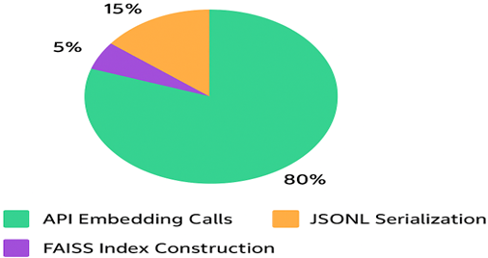
Results
Performance Breakdown of Embedding Pipeline Operations
A detailed analysis of the embedding pipeline revealed that API embedding calls accounted for 80% of the total operation time, while JSONL serialization and FAISS index construction contributed 15% and 5%, respectively. These insights guided targeted optimizations, resulting in faster processing and improved scalability for large-scale procurement document retrieval.

Slide 13
We built a rule‑based image classifier using features like edge density, color histograms, geometry, and aspect ratio—no ML/DL models involved.
It reliably separates procurement visuals (e.g., nov_logos: 487, monochrome: 324, content: 556) and filters headers, strips, and templates to reduce noise.
True_Label | brand_names | content | headers | icon | monochrome | nov_logos | nov_name | strips | templates | unknown | Total
brand_names | 25 | 1 | 0 | 4 | 0 | 1 | 3 | 0 | 0 | 0 | 34
content | 9 | 556 | 3 | 1 | 0 | 0 | 18 | 0 | 0 | 0 | 587
headers | 1 | 2 | 92 | 0 | 0 | 0 | 0 | 0 | 0 | 0 | 95
icon | 54 | 8 | 8 | 144 | 0 | 6 | 43 | 0 | 0 | 0 | 263
monochrome | 0 | 0 | 0 | 0 | 324 | 0 | 0 | 0 | 0 | 0 | 324
nov_logos | 0 | 0 | 0 | 0 | 0 | 487 | 0 | 0 | 0 | 0 | 487
nov_name | 1 | 47 | 0 | 16 | 0 | 0 | 285 | 0 | 0 | 0 | 349
strips | 0 | 1 | 0 | 0 | 0 | 0 | 0 | 112 | 0 | 0 | 113
templates | 13 | 25 | 15 | 65 | 0 | 0 | 8 | 0 | 125 | 0 | 251
Total | 103 | 640 | 118 | 230 | 324 | 494 | 357 | 112 | 125 | 0 | 2503
This hygiene step shrank the index, improved retrieval precision, and ensured only meaningful images are retained for ProcureAssistant results.

Slide 14
Category | Accuracy | Support
monochrome | 1 | 324
nov_logos | 1 | 487
strips | 0.9912 | 113
headers | 0.9684 | 95
content | 0.9472 | 587
nov_name | 0.8166 | 349
brand_names | 0.7353 | 34
icon | 0.5475 | 263
templates | 0.498 | 251
Class-wise results show that the rule-based image classification approach delivers strong accuracy for key procurement categories, with reliable separation of visuals like logos, monochrome images, and document content. The method demonstrates consistent performance across most classes, making it effective for automated document processing and organization.
The overall evaluation metrics highlight the evaluation metrics and consistency of the rule-based image classification system. High accuracy score across categories confirm that this approach is well-suited for automated procurement document processing, delivering reliable results without the need for machine learning.
Metric | Value
Total_Categories | 9
Total_Images | 2503
Correctly_Classified | 2150
Misclassified | 353
Overall_Accuracy | 0.859

Slide 15
Future Work
1. Vision & Deployment
The ProcureAssistant prototype will transition into a production-grade component of the Procurement Companion platform. This phase includes implementing enterprise-level security, scalability, robust error handling, and compliance with governance standards. These enhancements will ensure reliability and readiness for large-scale deployment.
2. Advanced Capabilities
Future iterations aim to evolve ProcureAssistant into an autonomous AI agent integrated across enterprise systems. Planned features include Outlook email integration for automated query responses, Microsoft Teams bot for natural language interaction, proactive alerts for expiring contracts, and multimodal retrieval for structured data extraction from diagrams and charts.
3. Governance & Intelligence
Upcoming enhancements will embed governance and transparency into the platform. Features include audit trail visualization for query-response lineage, policy enforcement layers to flag non-compliant actions, and feedback-driven retraining using RLHF signals. Adaptive caching and intent recognition will further optimize relevance and reduce latency.

Slide 16
References
[1] Retrieval-Augmented Generation for Knowledge-Intensive NLP Tasks
Lewis, P., Perez, E., Piktus, A., et al. (2020). arXiv:2005.11401.
https://arxiv.org/abs/2005.11401
[2] FAISS: A Library for Efficient Similarity Search
Johnson, J., Douze, M., & Jégou, H. (2019). Facebook AI Research.
https://github.com/facebookresearch/faiss
[3] Streamlit Documentation
Streamlit Inc. (2024). Official Documentation.
https://docs.streamlit.io/

Slide 17
Thank You

